Slide 1
A Question to Ponder
Even on systems with 1 CPU, users frequently run many problems at the same time. In CSSE220, I said that this happens via the OS "switching" really fast between all running processes, causing the illusion that processes are executing at the same time. But imagine that an assembly language program is running on the CPU and has a bug that causes it to infinite loop. Why doesn't this lock up the computer?
Well it would, but luckily it's no longer 1990 so we all have computers with multiple cores
The assembler has secretly inserted special instructions into the machine code which cause the program to occasionally switch back to the OS
The process doesn't directly run on the CPU, instead it runs on a simulated cpu that the OS manages and can stop
There is special hardware in the computer that stops the running program and runs OS code
The OS is written in a special assembly language that overrides ordinary assembly language instructions

Slide 2
A Question to Ponder
Even on systems with 1 CPU, users frequently run many problems at the same time. In CSSE220, I said that this happens via the OS "switching" really fast between all running processes, causing the illusion that processes are executing at the same time. But imagine that an assembly language program is running on the CPU and has a bug that causes it to infinite loop. Why doesn't this lock up the computer?
Well it would, but luckily it's no longer 1990 so we all have computers with multiple cores
The assembler has secretly inserted special instructions into the machine code which cause the program to occasionally switch back to the OS
The process doesn't directly run on the CPU, instead it runs on a simulated cpu that the OS manages and can stop
There is special hardware in the computer that stops the running program and runs OS code
The OS is written in a special assembly language that overrides ordinary assembly language instructions

Slide 3
What is an OS?
It’s a program – a program designed to be an abstraction layer and run other programs
BUT An OS is different from OO framework or web browser, because the programs it runs are assembly language that must be directly executed by the CPU
How can we build “abstractions” if our programs run directly on the hardware?

Slide 4
How will we study OS?
Primarily though programming low-level C and manipulating the abstractions through code
OS things are not magic, and I want you to learn that you can hack them as easily as anything else programmers build
Let’s look at the syllabus!

Slide 5
Abstractions we’ll learn about
Threads & synchronization
Files
Memory
Programs/Processes
Let’s talk about this one today

Slide 6

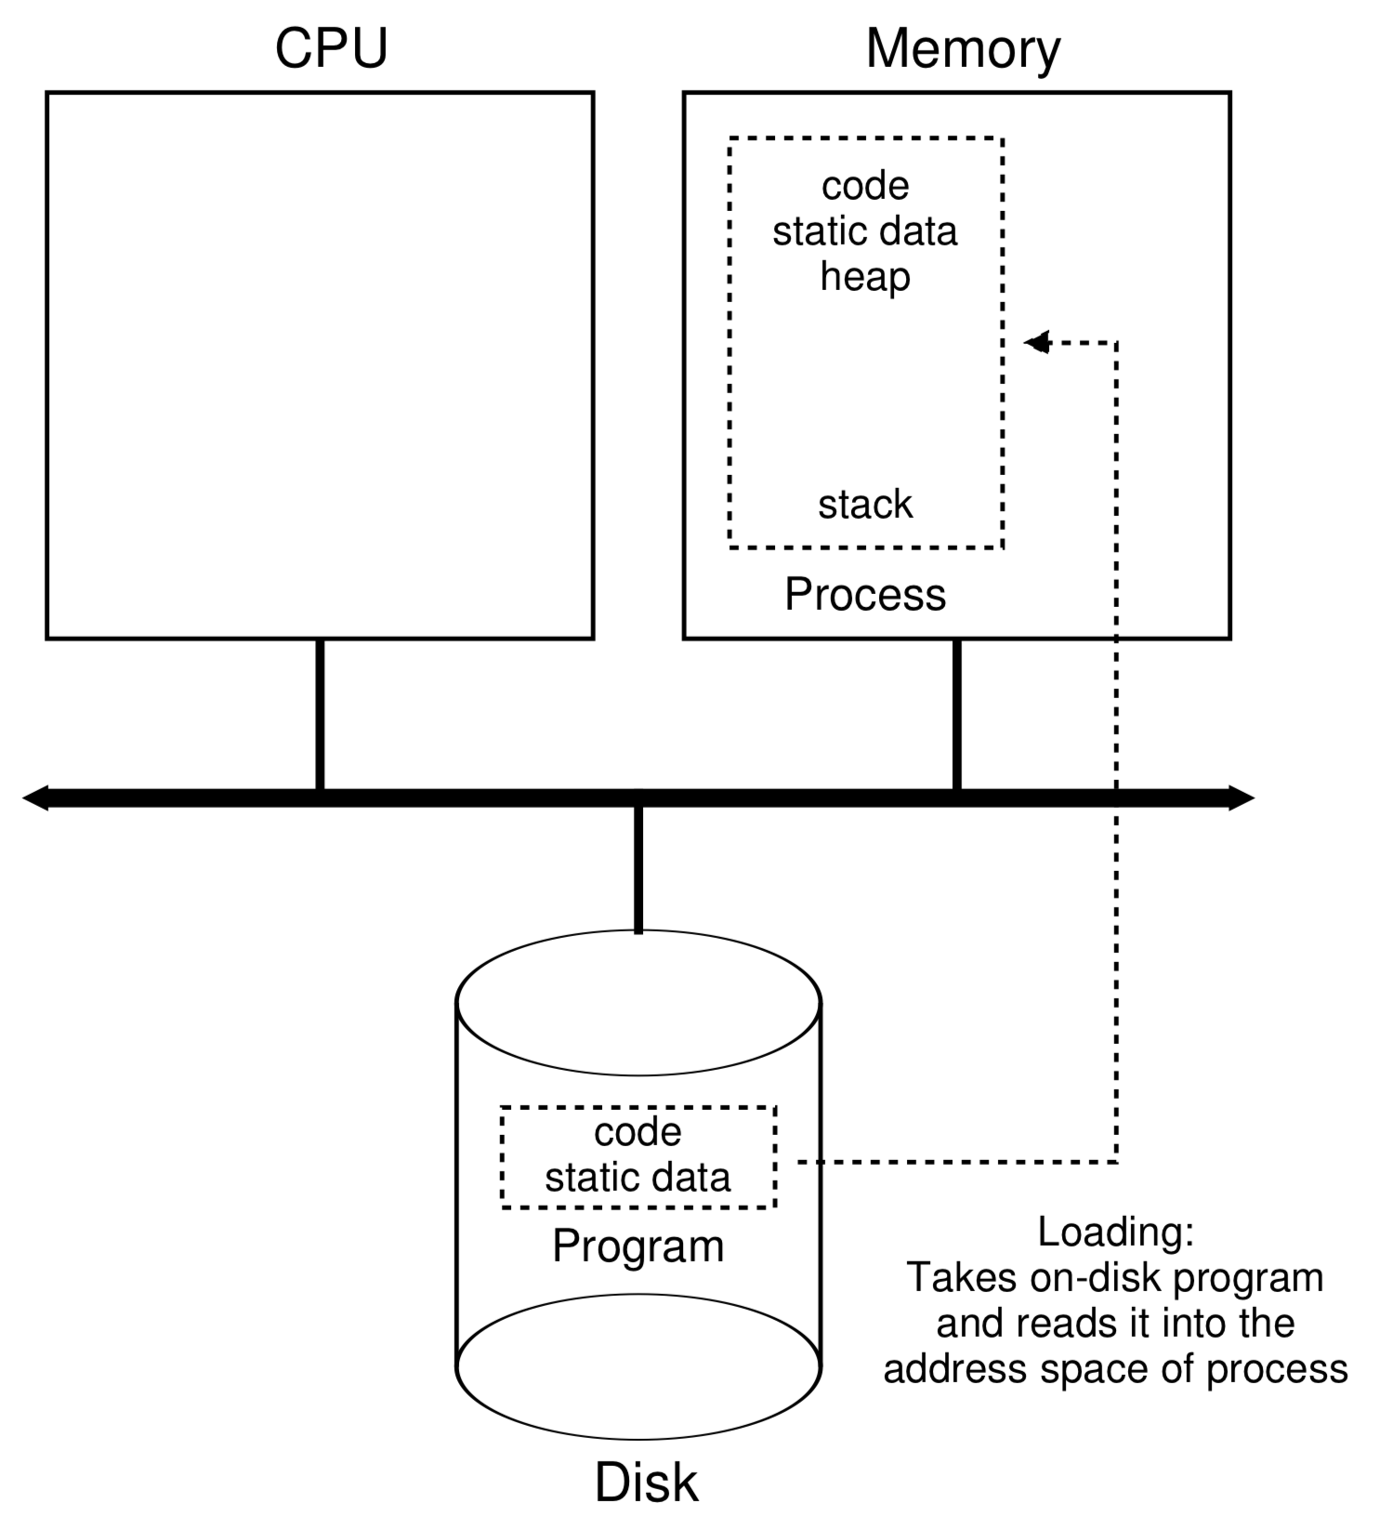
A process is a program in memory
Double click the icon

Slide 7
Process: Data Structure
In Linux, there is a struct task_struct that represents each process:
Each process has a process control block (aka struct task_struct) that stores its information
Process list is a linked list that keeps track of all the processes
I planed to show you the source code of struct task_struct, but…..
The definition of the struct includes 634 lines of code.
Adapted from Peter Bui @ND

Slide 8
Process Control Block
Process state
Program counter
CPU registers
CPU scheduling information
Memory-management information
Accounting information
I/O status information
**Many modern OS’s expanded process concept to support multiple threads, so PCB can also include threads info.
More details: https://en.wikipedia.org/wiki/Process_control_block

Slide 9
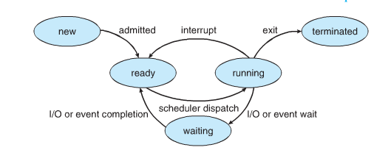
Process: States
A live process can be in one of five states:
Notes:
Use the functions in lab 1 to illustration

Slide 10
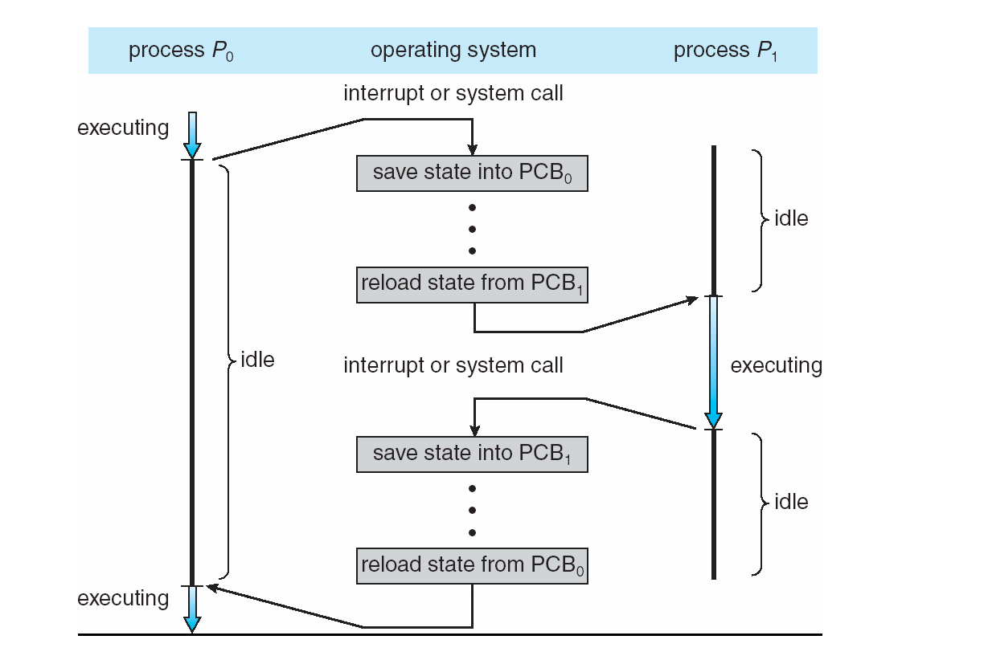
CPU Context Switch From Process to Process
Context-switch time is overhead; the system does no useful work while switching.
Time for context switch dependent on hardware support.
Notes:
Discuss here

Slide 11
What’s coming in the first third
Signals and interrupts – how we can disrupt normal program execution to allow the illusion of concurrency
Process creation (fork), process communication
Filesystems (sort of a standalone thing)

